Slide 1

Credit Card Services Customer Attrition
Johnny Thephavong
1/21/2022

Slide 2
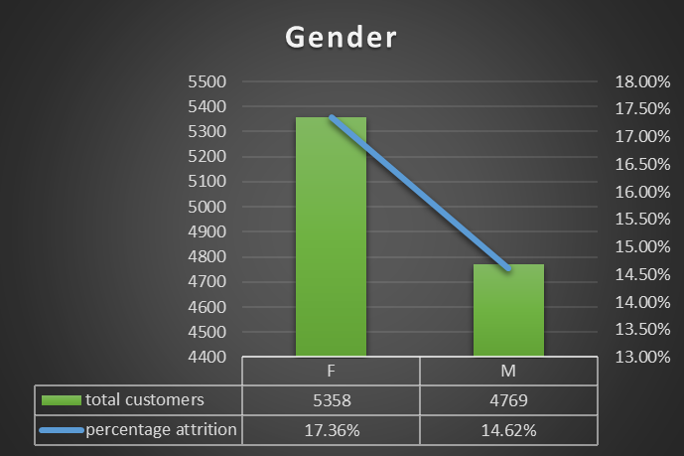
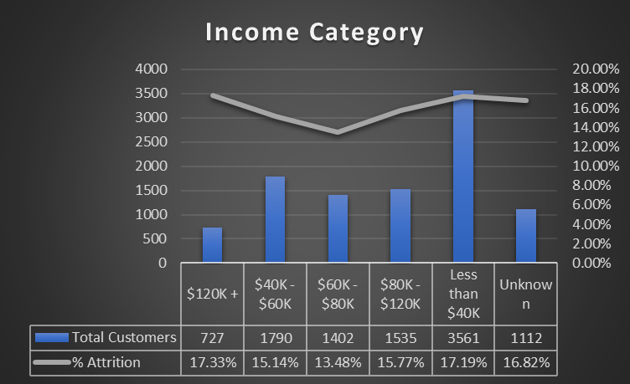
The bank has an issue with attrition of its credit card services. Currently, the attrition percentage of the total customer base is 16.07%. Through statistical methodologies, This issue can be approached by determining an equation with significant variables that help effectively develop a marketing strategy towards reducing attrition in the future.
Chi-Square tests of these variables determined them to be significant.
-The “Female” variable within
Gender more significant when present with other sig. variables.
-“$80k-$120k” & “$120k+” variables also more significant when present with other sig. variables.
-Including the “Female”, “$80k-$120k”, & “$120k+” variables in the high-level equation, increases the predictability of attrition to support the marketing team in determining an efficient strategy.

Slide 3
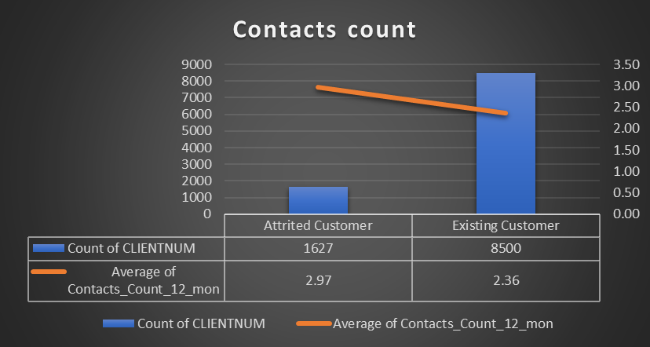
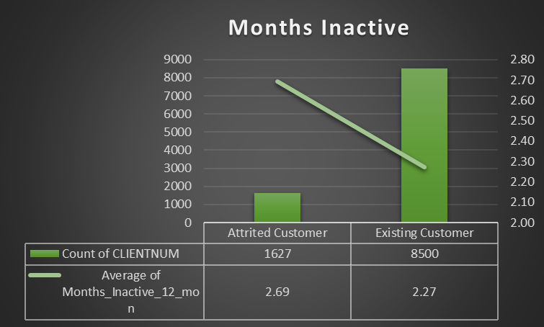
Statistical methodologies such as T-Tests, were used to determine significance in variables for the high-level equation that will be used to help the marketing team in developing a strategy to combat customer attrition.
By including both variables in the high-level equation, we can assume that developing a marketing strategy that involves an increase in customer contact and a decrease inactivity can help decrease attrition.

Slide 4
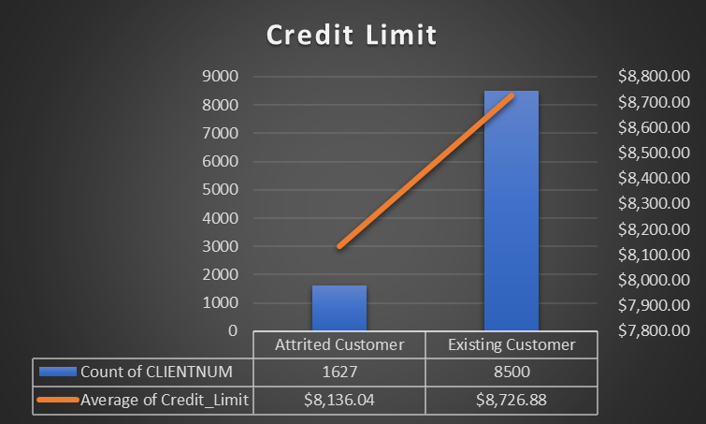
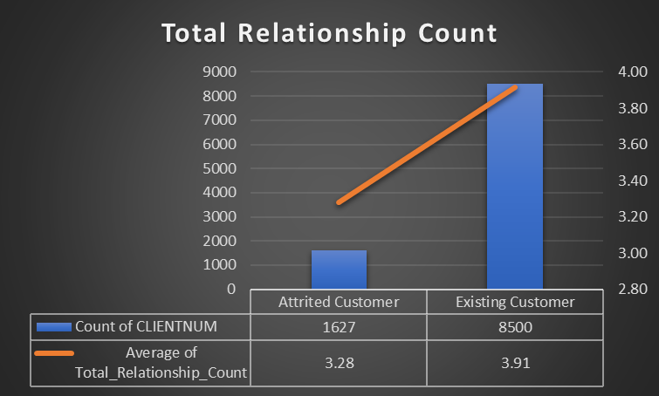
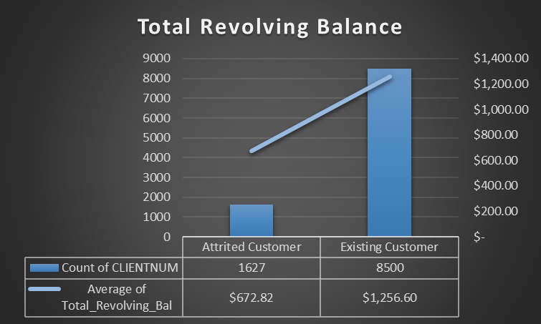
Initial T-Tests have determined that these variables were NOT significant, however after additional statistical methods were used it was determined that these variables WERE significant when other sig. variables were present.
- By including the “Credit Limit”, “Total Relationship Count”, and “Total Revolving Balance” in the high-level equation to determine a marketing strategy, we can assume that an increase in these variables will help combat customer attrition.

Slide 5
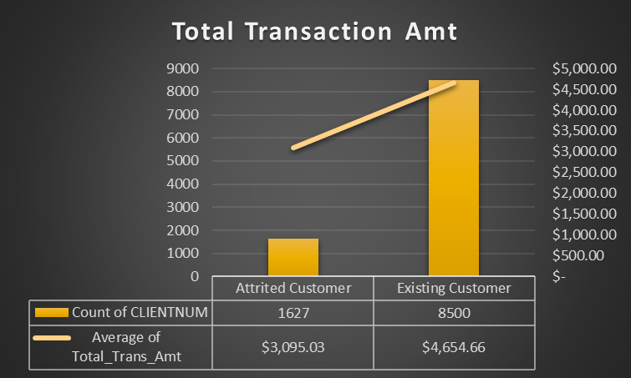
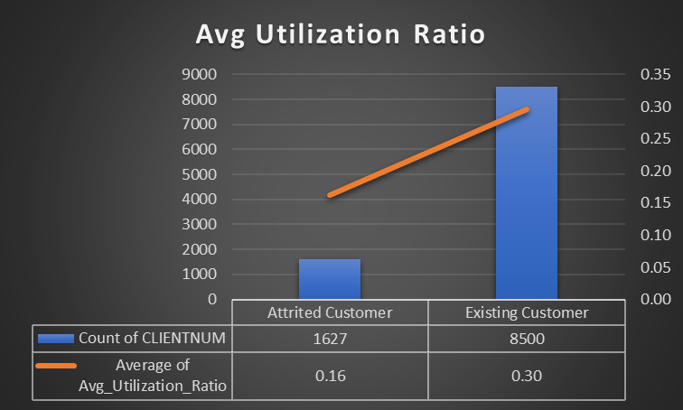
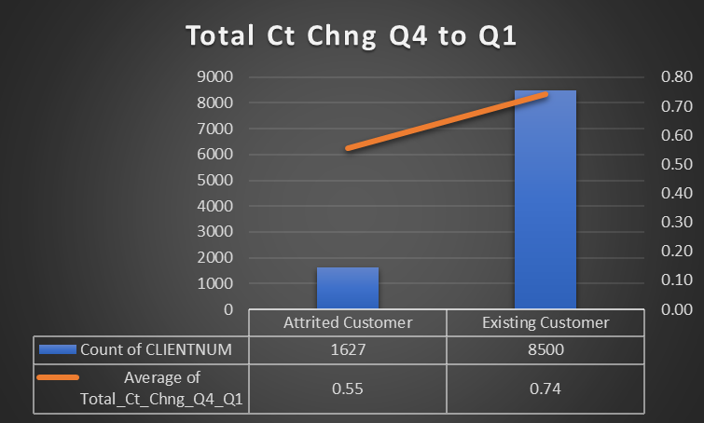
Additionally, these variables were also initially determined to NOT be significant by T-Tests. However, after further statistical methods. These variables were determined to be significant when present with other sig. variables.
- By involving these sig. variables in the high-level equation, the potential marketing strategy to approach attrition should see an increase in credit card usage and transactions.

Slide 6
Using statistical methodologies, eleven (11) significant variables were found to be associated with and have the most effect on customer attrition.
This association is called correlation which defines how close each variable is when compared to attrition.
Out of all the variables, these (11) are the most significant and closely associated with attrition.
Regression Coefficients are values that have the most effect on the determination of attrition for the statistical model.
These values are arranged from most(+) to most(-)
Variables with the most (+&-) association and effect:
Contacts_Count_12_Mon
Months_Inactive_12_Mon
Total_Revolving_Bal
Total_Ct_Chng_Q4_Q1
Avg_Utilization_Ratio

Slide 7
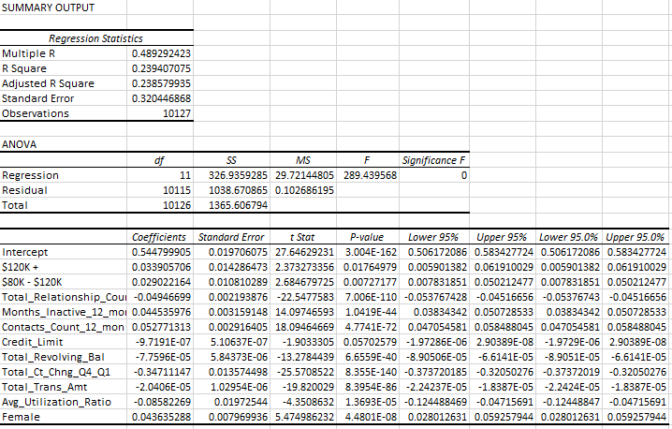
Incorporating the eleven (11) significant variables and their regression coefficient values, enabled their use as inputs for the creation of an equation that effectively models the prediction of customer attrition.
This model can potentially predict customer attrition helping in the development of an efficient marketing strategy in targeting customers to prevent this in the future.

Slide 8
To validate the high-level equation for the model, a gains chart is used to display the effectiveness and efficiency of the model vs. without a model. By using the model, the marketing team can determine a more efficient strategy to approach the issue of attrition.
For example, if the marketing team decided to target the top 20 percentile of the total customer base without a model, it can only expect to capture 20% of the attrition customers. (displayed by blue line)
However, if the team decided to target the same top 20 percentile of the total customer base with the model, it can expect to capture 65.15% of the attrition customers. (displayed by green line)

Slide 9
Insights
According to the Regression Model from the equation that was formulated to predict customer attrition, the variables that have the most effect and correlation on the model should be highly considered as a focus in the marketing strategy.
Contacts_Counts_12_mon
Months_Inactive_12_mon
Total_Revolving_Bal
Total_Ct_Chng_Q4_Q1
Avg_Utilization_Ratio
It is highly recommended that the marketing team consider the regression model in the determination of a strategy to address the issue of attrition. The model presumably increases efficiency while decreasing impact on resources.

